Slide 1
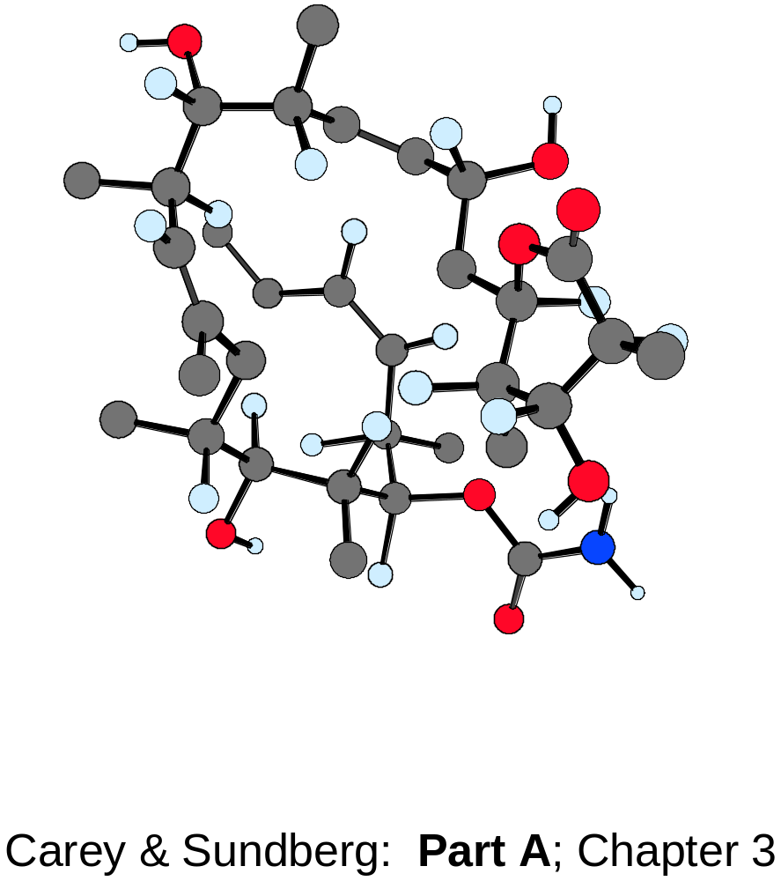
Conformational Analysis

Slide 2
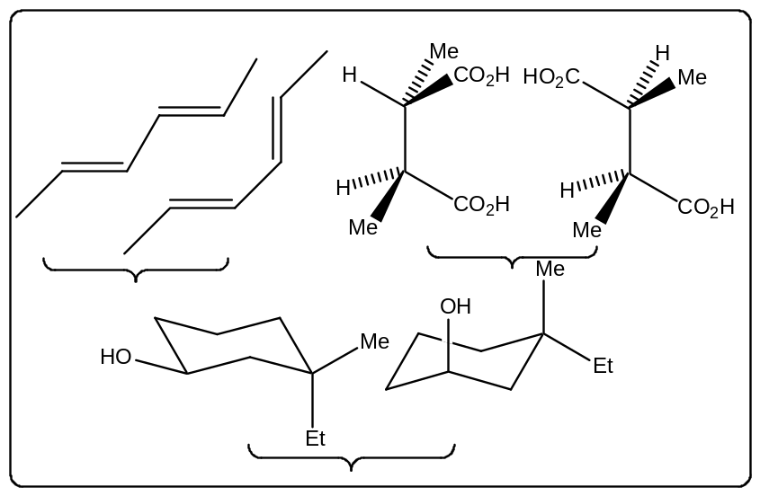
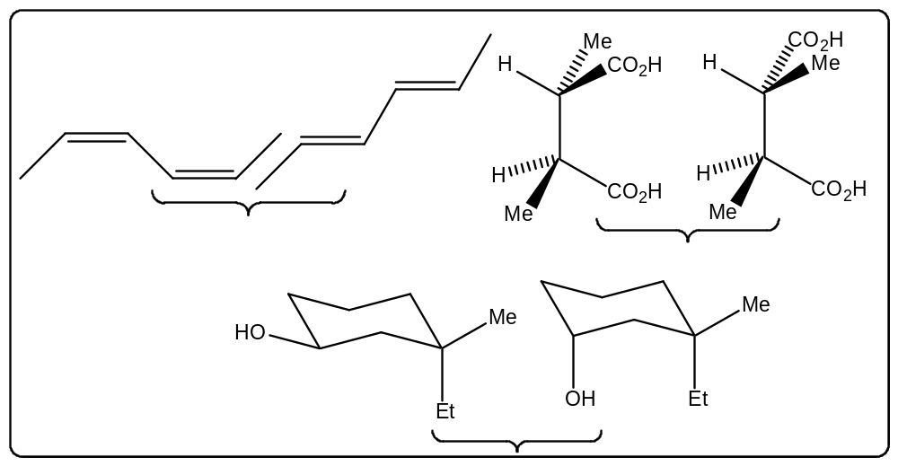
Conformational analysis
The different arrangements of the atoms in space that result from rotations of
groups about single bonds are called conformations of the molecule.
An analysis of the energy changes that a molecule undergoes as groups rotate
about single bonds is called conformational analysis.
Different conformations
Different configurations

Slide 3
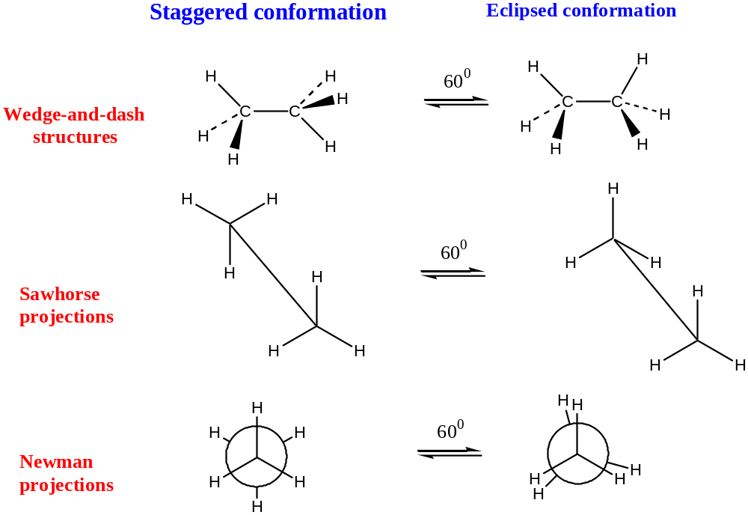
Conformations of ethane

Slide 4
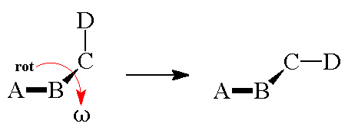
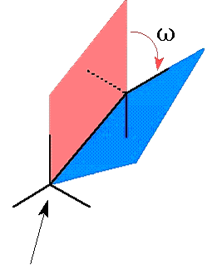
Torsion or Dihedral angle
The single parameter differentiating such conformers is an angle between two planes that contain atoms ABC and BCD in themselves. This dihedral angle ω is called a "torsion" angle and is most frequently used for specification of the type of conformations.

Slide 5
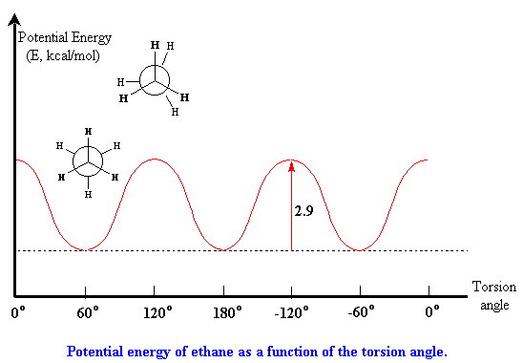
Potential energy of ethane as function of torsion angles
staggered conformation has potential energy minimum
eclipsed conformation has potential energy maximum
staggered conformation is lower in energy than the eclipsed by
2.9 kcal/mole (12 kJ/mole)

Slide 6
Why is the eclipsed conformation higher in energy
than the staggered conformation?
The H-atoms are too small to get in each other’s way-steric factors make up < 10% of the rotational barrier in ethane

Slide 7
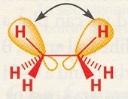
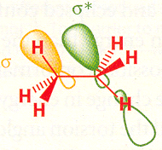
Torsional strain
Caused by repulsion of the bonding electrons of one substituent with the bonding
electrons of a nearby substituent
filled orbitals repel
Stabilizing interaction between filled C-H σ bond and empty C-H σ * antibonding bonding orbital
The real picture is probably a mixture of all 3 effects
The rotational barrier is (12 kJ/mol) small enough to allow the conformational isomers
to interconvert million of times per second

Slide 8
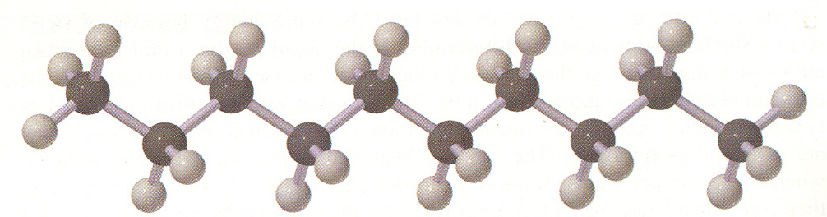
Conformations and Conformers
Butane can exit in an infinite number of conformations (6 most important have
been considered), but has only 3 conformers (potential energy minima)-the two
“gauche”conformations and the “anti” conformations
The preference for a staggered conformation causes carbon chains to orient themselves in a zig zag fashion, see structure of decane

Slide 9
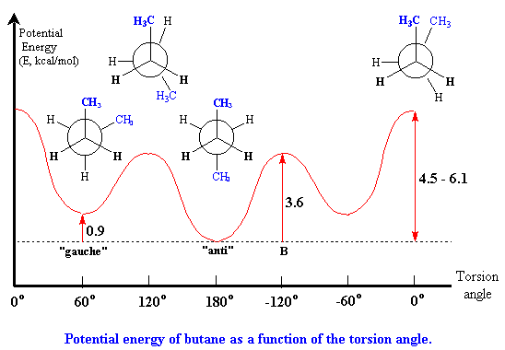
Conformations of butane
D
B
A
C
Potential energy of butane as a function of torsion angle
A ➔ “gauche”
B ➔ “ Partially eclipsed”
C ➔ “anti”
D ➔ “fully eclipsed

Slide 10
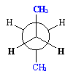
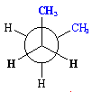

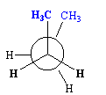
C ➔ “anti”
No torsional strain as the groups are staggered and CH₃ groups are par apart
A ➔ “gauche”
van der Waals forces between two CH₃ groups are repulsive: the electron clouds repel each other which accounts for 0.9 Kcal/mole more energy compared to anti conformer
Calculations reveal that at room temperature ~72% of the molecules of
butane are in the “anti” conformation, 28% are in “gauche”
conformation
B ➔ “partially eclipsed”
torsional strain and large van der waals repulsive forces between the H and CH₃ groups
D ➔ “fully eclipsed
Highest energy due to torsional strain and large van der waals repulsive force between the CH₃ groups

Slide 11
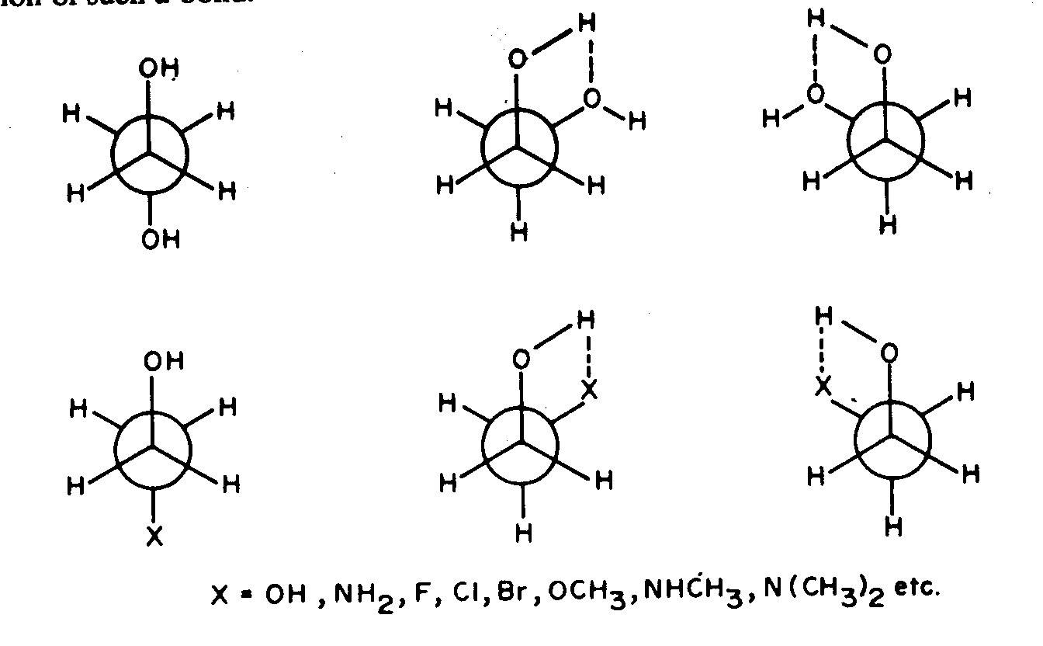
Conformation and hydrogen bonding

Slide 12
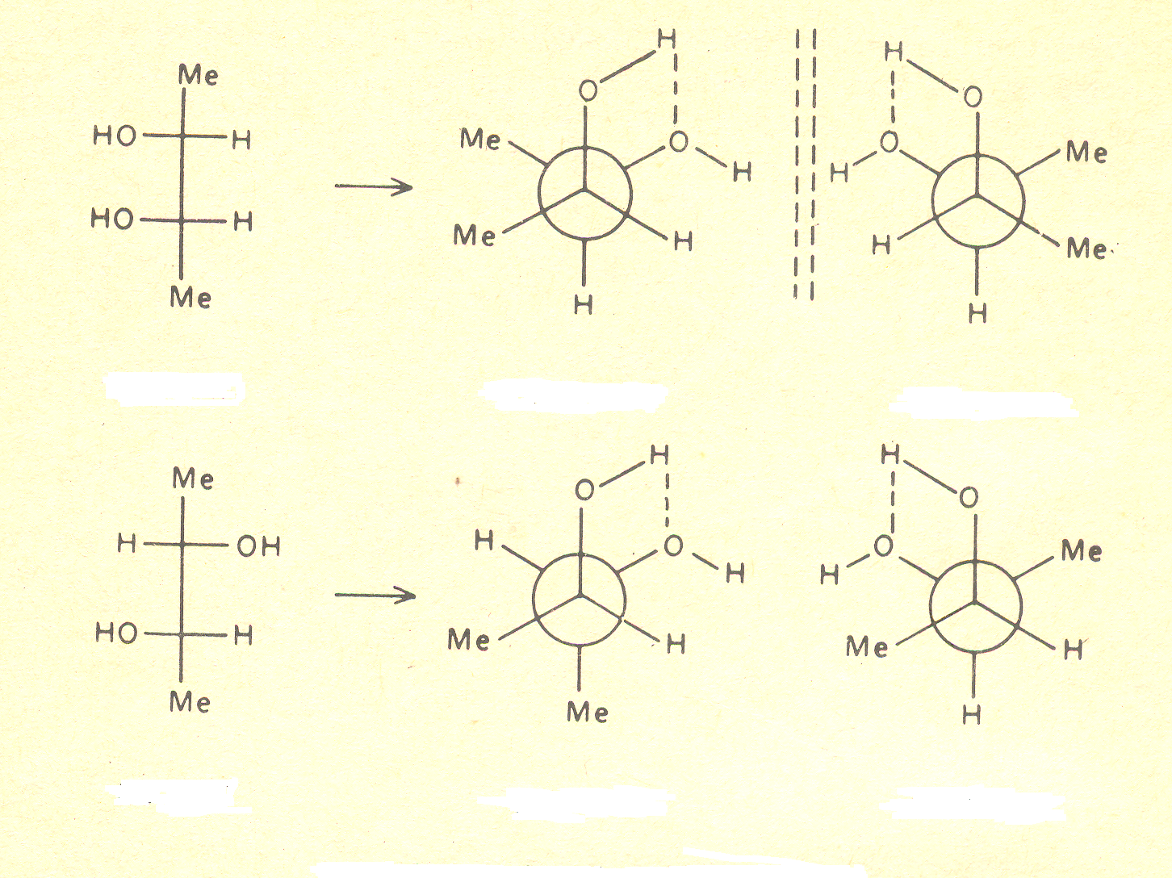
Conformation of butane-2,3-diols

Slide 13
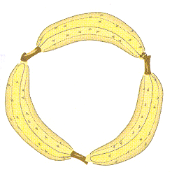
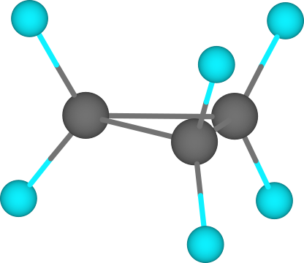



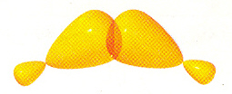
Cyclic compounds twist and bend to minimize the 3 different kinds of strain
1. Angle strain 2. Torsional strain 3. Steric strain
Cyclopropane
banana bonds
poor orbital overlap
HCH 115°
Electron density diverts away from the ring by 21°
Torsional strain
For sp³: 25% s & 75% p charector
Here the four hybrid orbitals of C are far from equivalent
Good overlap
Strong bond
External orbitals: 33% S & 67% p ➔ sp²
Internal orbitals: 17% S & 83% p ➔ sp⁵
Poor overlap
Weak bond

Slide 14
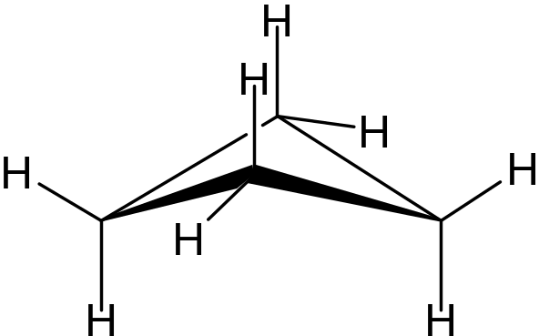
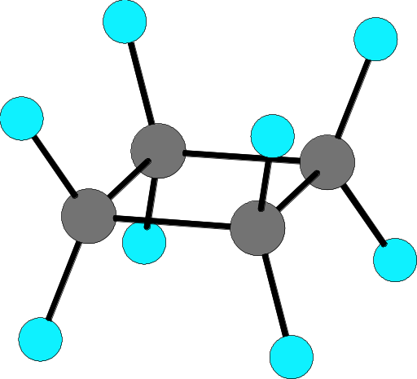

Cyclobutane
to reduce torsional angle
Interplanar angle 35°

Slide 15
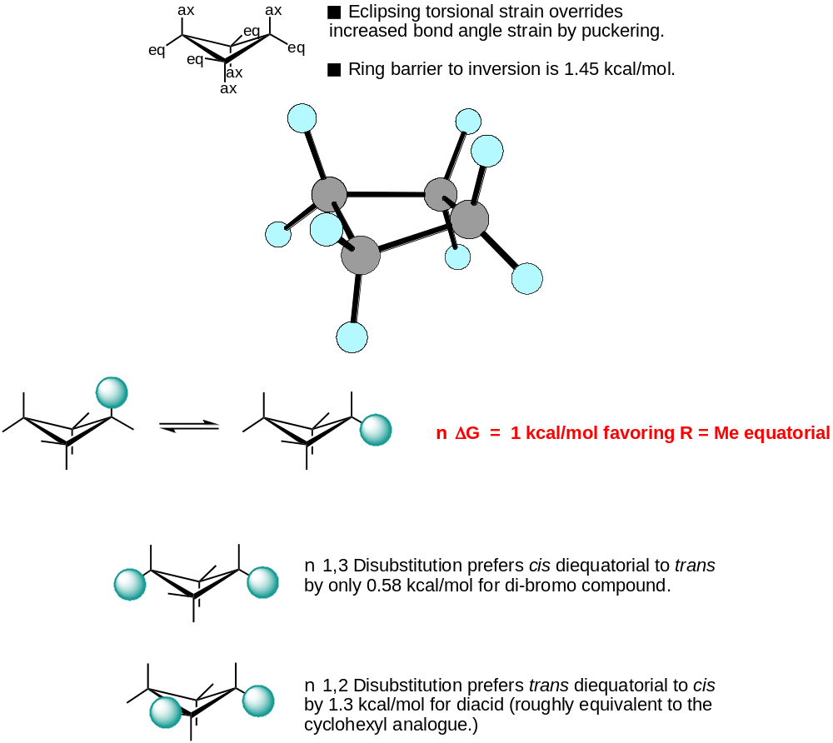
Cyclobutane

Slide 16
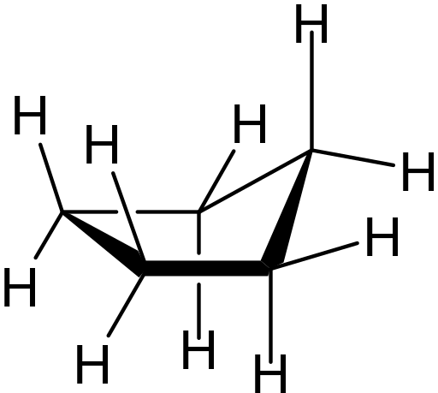
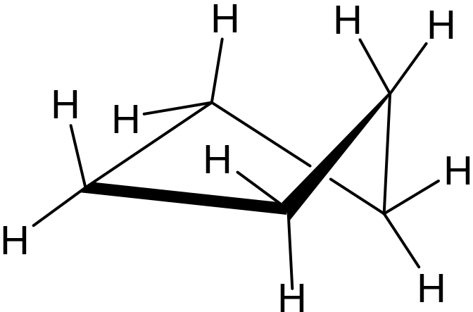
Cyclopentane
Envelope
Half chair
The energy difference is little
one carbon atom is bent upwards
The molecule is flexible and shifts conformation constantly
Hence each of the carbons assume the pivotal position in rapid succession .
The additional bond angle strain in this structure is more than compensated by the reduction in eclipsed hydrogens.
With little torsional strain and angle strain, cyclopentane is as stable as cyclohexane.

Slide 17
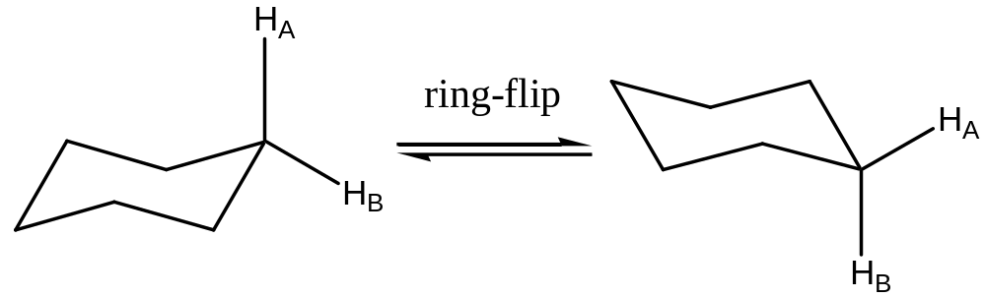
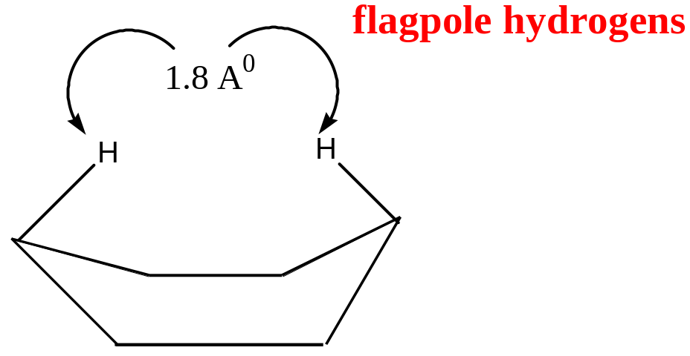
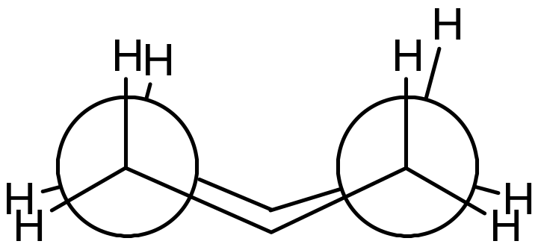
Cyclohexane
Chair conformation
Sum of the van der Waals radii = 2.4 A⁰
Boat conformation
Newman projection of the
boat conformation

Slide 18
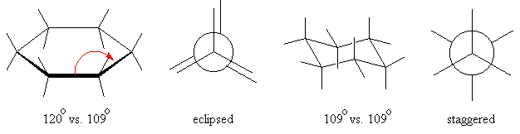
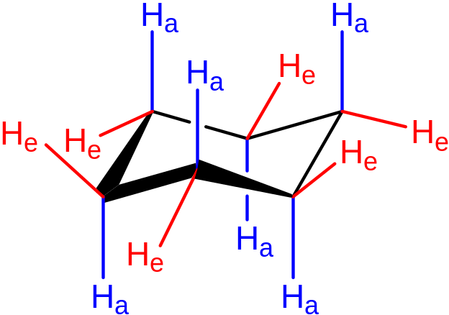
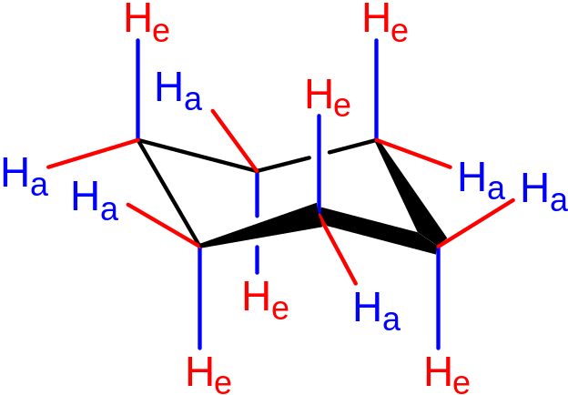

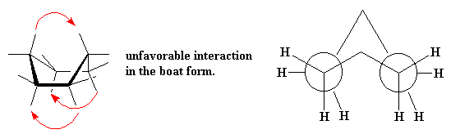
Ring flipping or
inversion

Slide 19







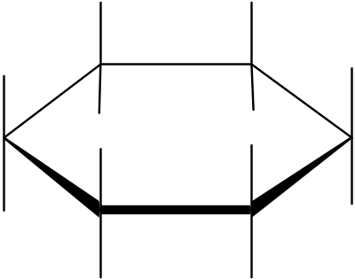
Interconversions of Cyclohexane
Chair
Half Chair
Twist boat
boat
Erel=0.0 kcal/mol
Erel=10
Erel=5.5
Erel=6.5
Twist boat
Opposite sense
Half Chair
Opposite sense Chair
Planar Erel= very large >20 kcal/mol

Slide 20
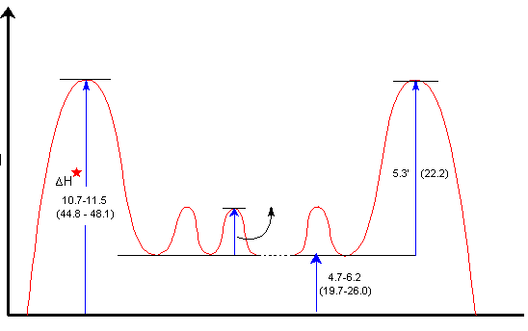
Cyclohexane energy profile for cyclohexane ring reversal
Half chair
Half chair
ΔH
boat
1-1.15
(4.2-6.3)
Twist boat
chair
chair
The energy difference between the chair, boat, and twist conformation of cyclohexane are low enough to make their separation impossible at r.t. At room temperature approx. 1 million introversions occur each other second.
More than 99% of the molecules are estimated to be in chair conformation at any given time

Slide 21
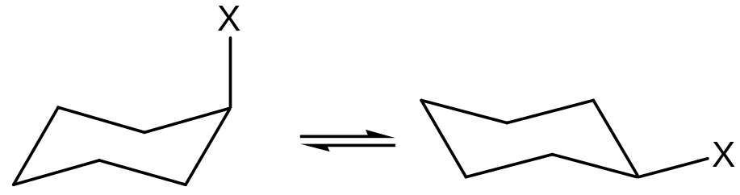
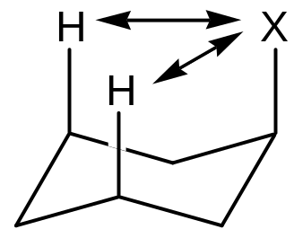
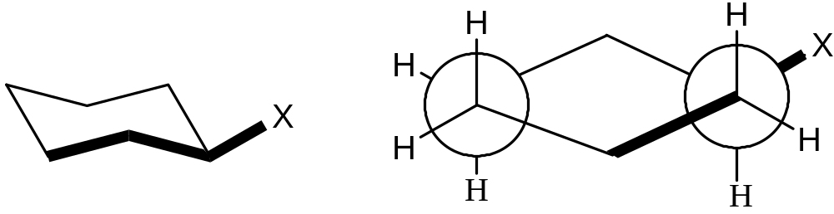
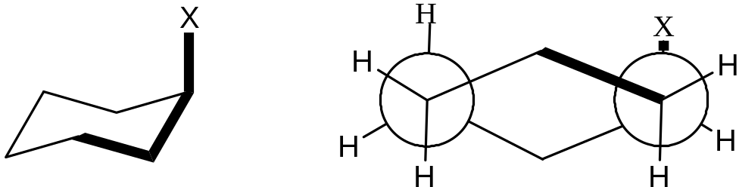
Monosubstituted cyclohexane
This conformation is lower in energy
Why?
When X=CH₃, conformer with Me in axial is higher in energy by 7.3 kJ/mol than the corresponding equatorial conformer.
Result: 20:1 ratio of equatorial:axial conformer at 20⁰ C
1,3-diaxial interaction
The black bonds are anti-
periplanar
(only one pair shown)
The black bonds are synclinal
(gauche)
(only one pair shown)

Slide 22
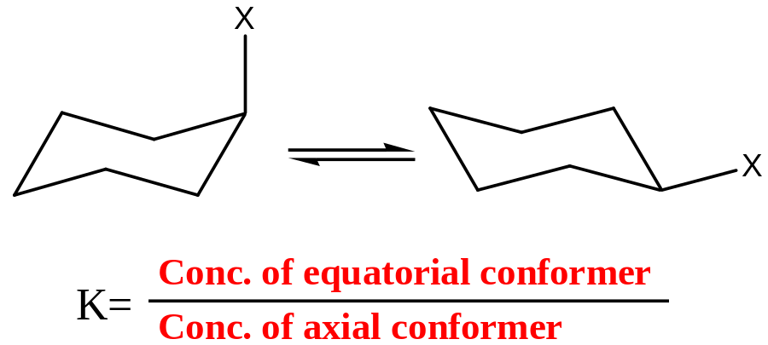
X | Equilibrium constant | Energy diff. between axial and equatorial conformers kJ/mol | % with substitutent equatorial
H | 1 | 0 | 50
Me | 19 | 7.3 | 95
Et | 20 | 7.5 | 95
i-Pr | 42 | 9.3 | 98
T-Bu | >3000 | >20 | >99
OMe | 2.7 | 2.5 | 73
Ph | 110 | 11.7 | 99

Slide 23
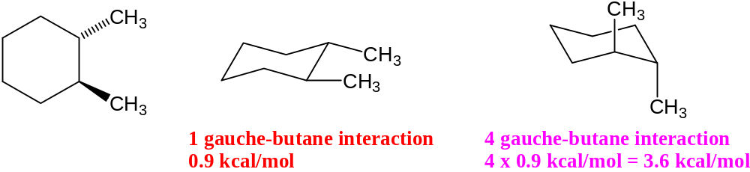
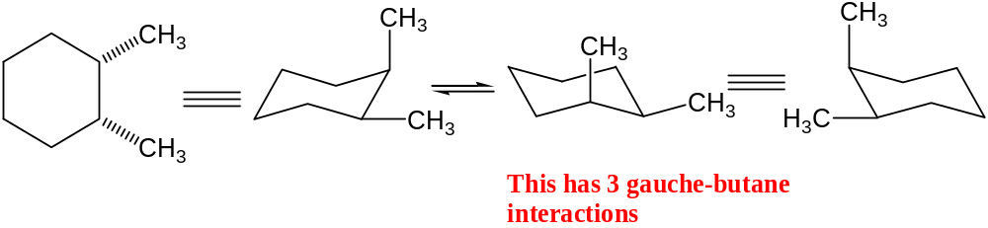
Diastereomeric, chiral and therefore resolvable
Enantiomeric, chiral and not resolvable
It exists as a dl-pair, but since barrier to rotation is low to allow separation.
Therefore the (±)- pair is inseparable and hence the compound is optically inactive.

Slide 24
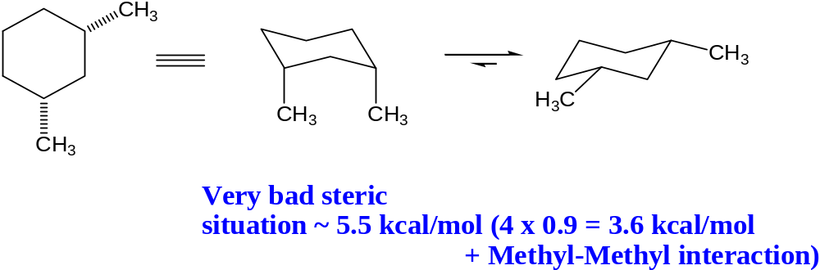
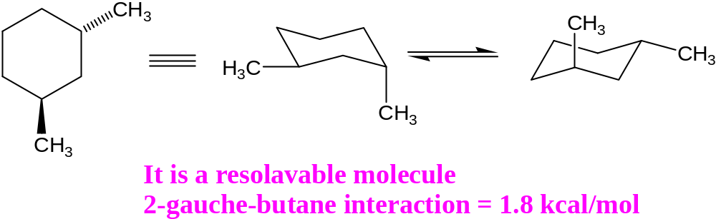
Diastereomers, achiral
Identical, chiral
cis-isomer is stable than trans isomer

Slide 25
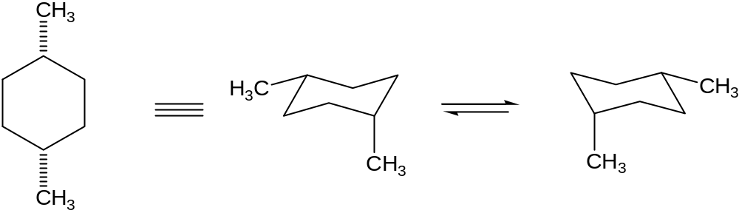
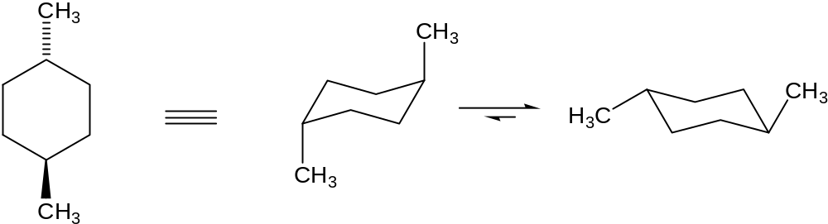
Identical, achiral
Diastereomers, achiral
Both have plane of symmetry, achiral
Trans is stable than cis

Slide 26
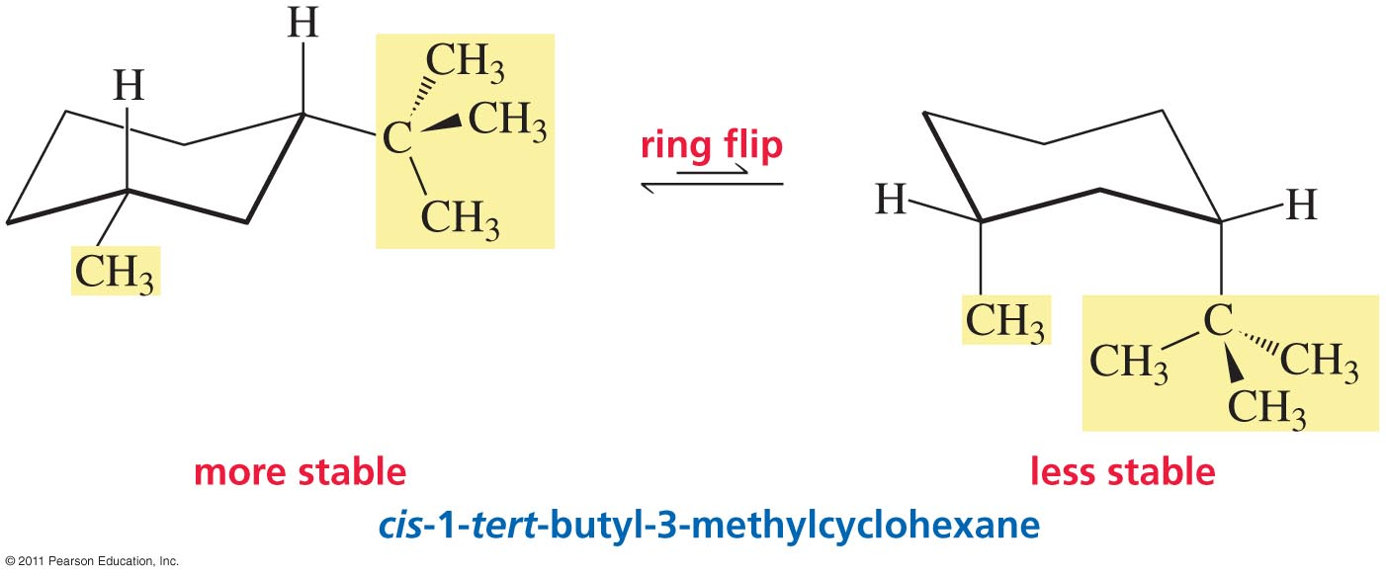
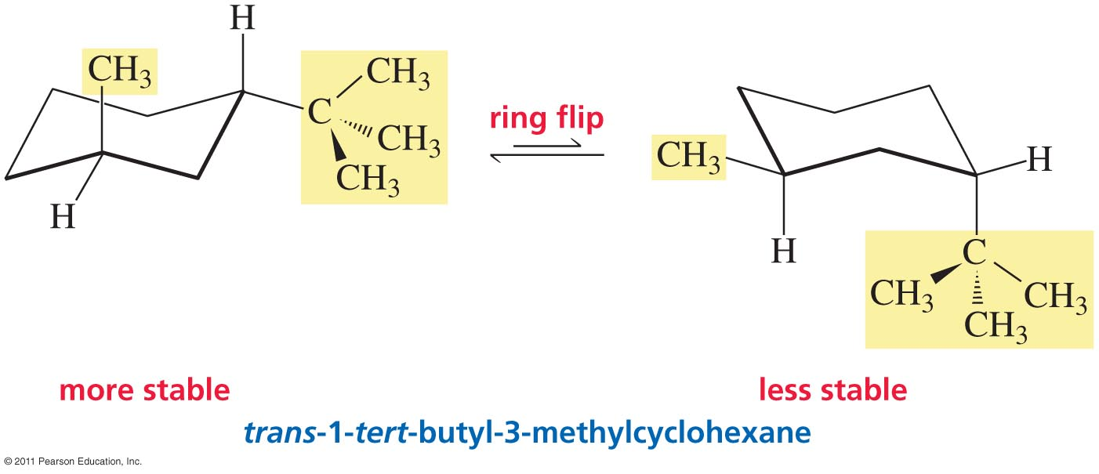
1-tert-Butyl-3-Methylcyclohexane

Slide 27
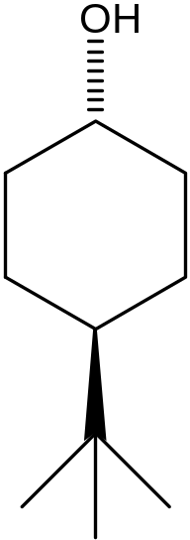
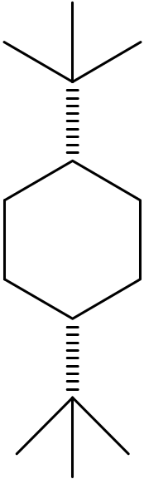
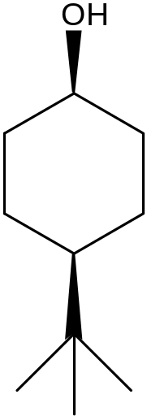
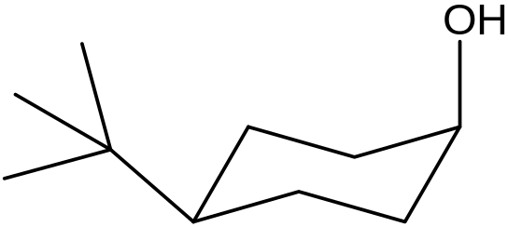




Preferred Conformations
Disfavoured
t-butyl group
a locking group
Twist boat

Slide 28


Write preferred conformation for

Slide 29


Slide 30

Rigid molecules from cyclohexane conformers

Slide 31


Slide 32

Conformational Analysis of Bicyclic Systems

Slide 33

Bicyclic Systems

Slide 34


